Slide 1
ADMN410 - MIS
Publishing to ADMIN Server

Slide 2
Server Name
ADMN410.UNH.EDU
Note: the name of this server changed on 4/19/18 from ADMIN.UNH.EDU
The “I” in ADMIN was removed

Slide 3

Download Filezilla FTP Client and Install
WINDOWS: https://unh.box.com/s/6zelhqchqmvcpdsj1x5ln9ifpdt7ulbc
MAC: https://unh.box.com/s/eqcmrfrvqvjbgy17gcvtd6m9h23bbw68
Notes:
This version may be updated since this slide presentation was created

Slide 4
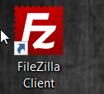
Launch Filezilla and Connect
Double click on the FileZilla Client icon to start the application
Note: You should do this while on campus
If you are not on campus, you will also need to install Pulse (vpn). Instructions are provided in the link below
https://www.library.unh.edu/services/technical-support/using-unh-vpn

Slide 5
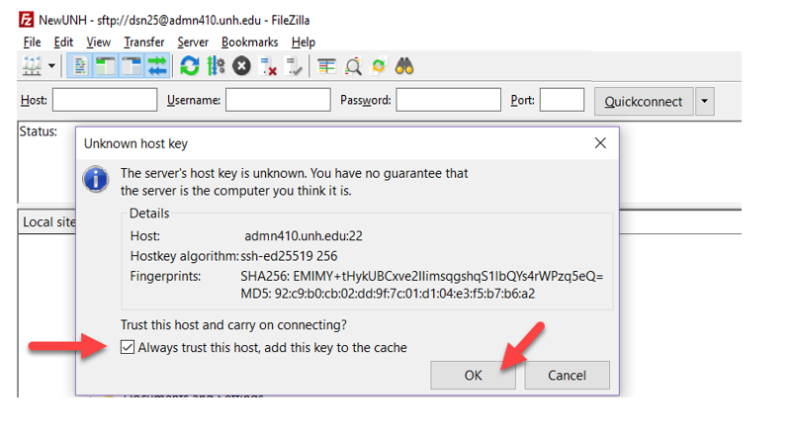
Trust the Host (If you get this message)

Slide 6
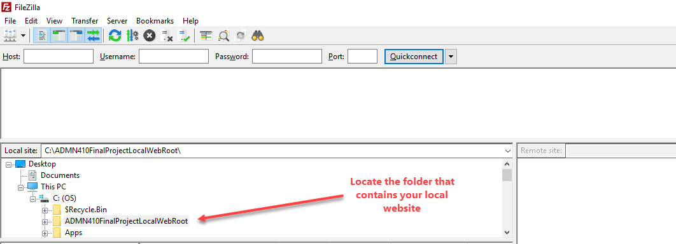
Locate the folder
Locate the folder that contains the version of your website that is on your machine

Slide 7
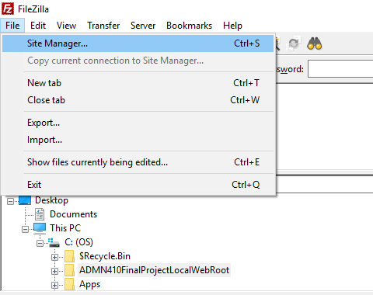
Create connection to UNH Server
Configure a connection to the UNH Web Server
1) Choose File>Site Manager

Slide 8
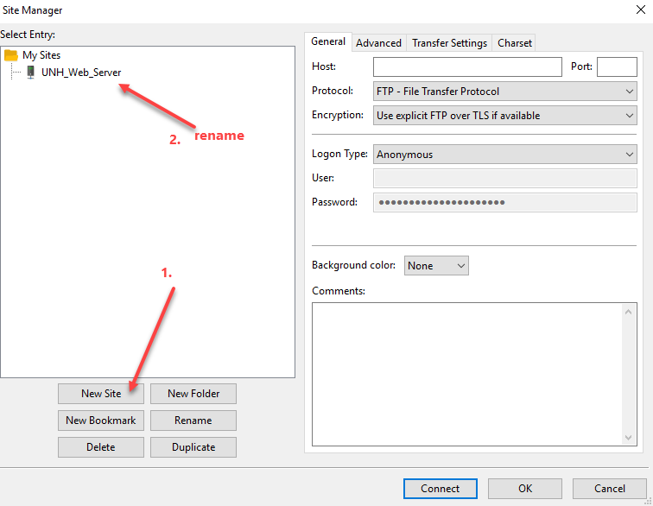
Add a New Site and Rename
When you create a new site, it will be called New Site by default. Change the name!

Slide 9
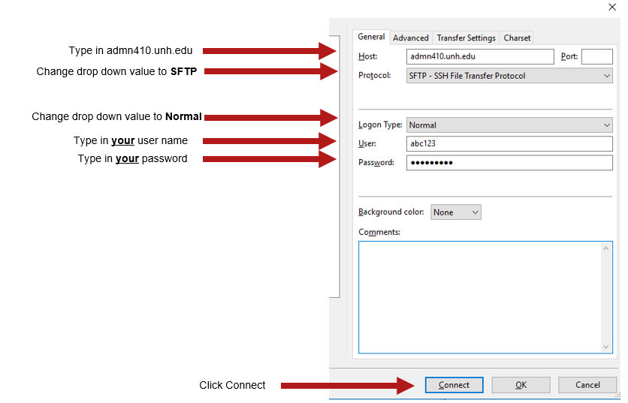
Add host Information

Slide 10
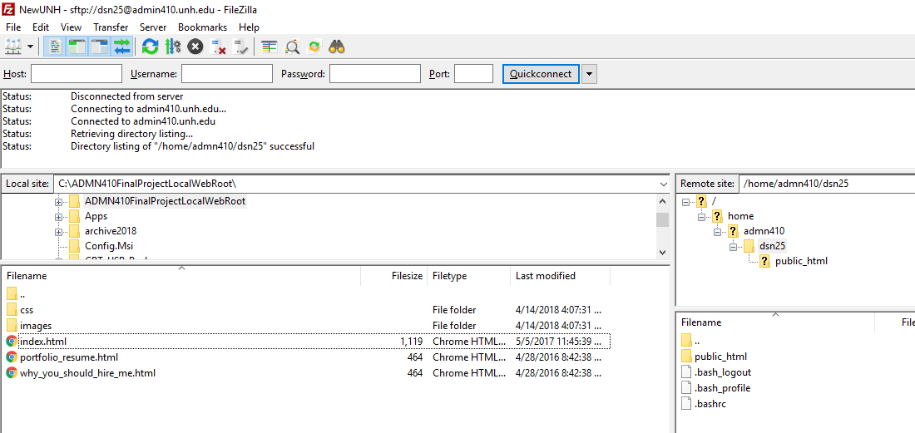
Navigate to the public_html folder
Your Machine
ADMN410 Web Server
Double-Click your username to expand the public_html folder

Slide 11
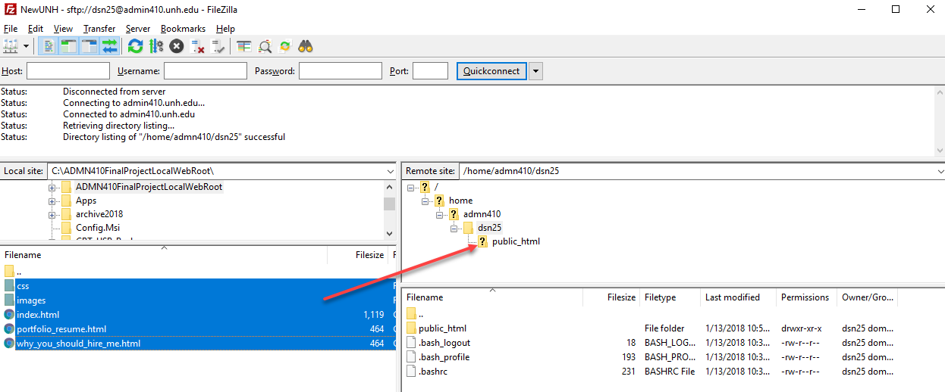
Copy files from to public_html folder
Your Machine
ADMN410 Web Server
Select all of your html files as well as your css and images folders on your local machine
Drag and drop them directly to your public_html folder on the UNH Web Server

Slide 12
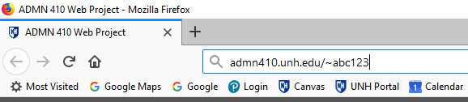
Test your website
Open up your browser
Type in: admn410.unh.edu/~
after the ~, type in your username
Your index.html web page should render in the browser

